Slide 1
Social Media Roundup
Bad social media:
7 Ways to lose your audience

Slide 2
Social Media Roundup
Agenda
The Social Media Roundup is designed to provide social media best practices and tried and true methods. But it’s not always about what you could be doing better, sometimes it’s important to identify what you’re doing wrong. This Social Media Roundup will outline the mistakes made on social media that can negatively affect your audience and your organization’s reputation.
Introduction
#1: Over posting or over Tweeting
#2: Topic overload
#3: Failure to engage
#4: Social media ghost ships
#5: Negative engagement
#6: All vegetables and no dessert
#7: Too much self promotion

Slide 3
Introduction
Social Media Roundup
Don’t let anyone tell you that social media is easy. It’s hard work. It takes time, planning and effort to make sure your organization’s voice is informative and authentic.
Studying social media best practices is crucial if you want your organization to be successful, but it’s also important to study what others have done wrong.
Avoiding the mistakes that others have made can help your organization avoid making the same mistakes.
Taking social media risks is part of the job, but if someone else has already taken the risk and it turned out poorly, learn from their mistakes rather than making your own.

Slide 4
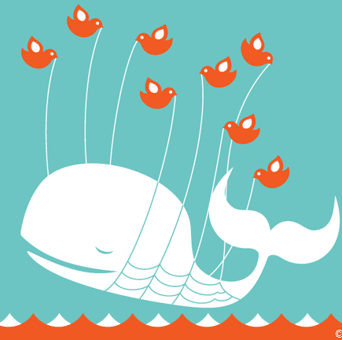
#1: Over posting or over Tweeting
Social Media Roundup
All organizations have a lot to say. All organizations are doing great things. But depending on the size of your social media audience, not every press conference, training exercise or organizational update is worth a Facebook post or Tweet.
Evaluate the size of your social media audience. If you have a large social media audience, then 3-5 Facebook posts or Tweets a day is reasonable. If you have a few hundred “likes,” 3-5 posts may be a little excessive. It’s important to know what your audience wants.
If you have less than 100 “likes” on Facebook and you’re posting 10 times a day, it may be time to reevaluate your social media strategy.

Slide 5
#2: Topic overload
Social Media Roundup
Topic overload happens when your organization posts or Tweets about a specific topic or event nonstop without providing other content to break up the flow from time to time.
Even the U.S. Army has been guilty of topic overload in the past. Events like Medal of Honor ceremonies and major Army initiatives create the desire to post only content that relates to that event or initiative. But focusing too much on a specific topic can turn your audience off.
It’s perfectly acceptable to have a social media focus for a few days, but be sure to continue to post additional unrelated content so your audience doesn’t become bored with your message.

Slide 6
#3: Failure to engage
Social Media Roundup
Social media, by definition, is social. If you have a social media presence, you must engage with your audience on that social media presence.
Whether that means liking comments, answering questions, or asking questions of your social media audience, you must engage.
Social media is time consuming, and engaging on a regular basis adds to the time you dedicate to social media, but if you’re not engaging on your social media presence, your audience will figure it out, and they will likely move on if they know you’re not listening.

Slide 7
#4: Social media ghost ships
Social Media Roundup
Starting a social media presence is always a good idea at first, but after a few months, some organizations stop caring about social media as much. Some organizations stop posting all together.
Once an organization stops posting, the social media presence continues to exist. That Facebook Page that people have “liked” or that Twitter account people have followed still exists. It floats through the Internet like a social media ghost ship. The presence still exists, but nobody is on the ship.
This is a major problem in the Army. Do not create a social media ghost ship. If you don’t have the time to manage a social media presence, don’t create one. If you find that after a few months, social media is not good for your organization, delete the presence. Social media ghost ships reflect poorly on the organization and the Army as a whole.

Slide 8
#5: Negative engagement
Social Media Roundup
Social media is a place for individuals to interact and express their opinions. Occasionally, those opinions do not sync up with the positions of your organization.
If the comments violate your organization’s terms of use statement, they are easy enough to delete, but if they don’t, you need to leave them up.
Unfortunately, some organizations have difficult time crafting professional responses to negative comments that appear on their Facebook Pages or are directed toward their Twitter accounts.
Your social media presence is a reflection of your organization, so always remain professional. There is never a good time to lash out at a follower of your social media presence. Keep it professional at all times, or say goodbye to your social media audience.

Slide 9
#6: All vegetables and no dessert
Social Media Roundup
As a social media manager, one of your primary functions is to post information that supports your organization’s communication priorities.
Not all of this information is fascinating stuff. It’s your job as a social media manager to either turn those pieces of information (vegetables) into interesting information (dessert) or make sure your follow up your somewhat dull content with content your audience is sure to like.
It’s your job to put out certain pieces of information, but it’s also your job to keep the audience interested and coming back. If you can’t find a way to balance the vegetables with the dessert, then you’ll eventually end up eating dinner alone.

Slide 10
#7: Too much self promotion
Social Media Roundup
Organizational and unit pride are important, but not everybody following your social media presences is in your organization.
While self congratulatory posts are acceptable from time to time (like when the organization wins an award or a unit returns from a deployment) too many of them can make your organization seem a bit full of itself.
Let your followers pat you on the back, don’t do it yourself. If you post relevant content about your organization’s success, your social media audience is likely to offer you the praise you deserve.

Slide 11
Contact information
Social Media Roundup
Have questions? Please feel free to reach out to us at the Online and Social Media Division
Email:
Ocpa.osmd@us.army.mil
To review and download past editions of the Social Media Roundup, visit our Slideshare site at: http://www.slideshare.net/usarmysocialmedia. All Social Media Roundups are authorized to be distributed to a broader audience.
9/26/2012
OFFICE OF THE CHIEF OF PUBLIC AFFAIRS
PENTAGON

